Slide 1
Graphic designer
Task A: The golden ratio
1) Design a logo for a company using the golden ratio template.
Write a paragraph detailing why your logo represents the company well.
For example, if you chose a restaurant chain and you designed a burger then this logo is in keeping with what the restaurant chain stands for.
E.g. Using the template, I placed circles in each smaller section.
I have designed a logo for a company that sells products aimed at toddlers.
The teddy is made from circles which means the teddy has a soft ‘round’ appearance. It looks cuddly and safe for children.

Slide 2
Graphic designer
Task B: Rotational symmetry in art
1) a) Create a design using basic shapes. Your design should have rotational symmetry.
b) Create a second version of your design that does not have rotational symmetry.
Design 1
Design 2

Slide 3
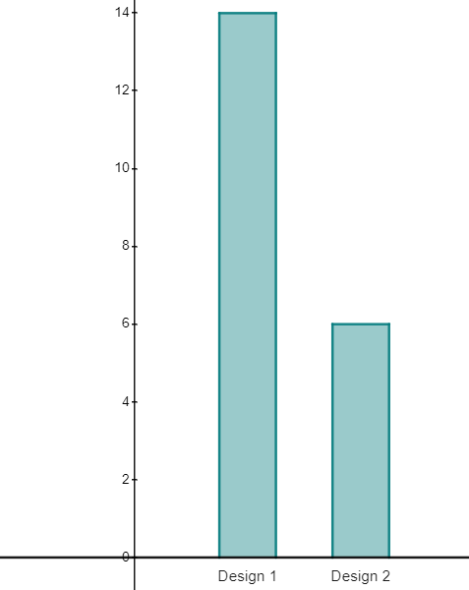
Graphic designer
2) Show your two designs to your classmates/friends/family. Ask them ‘Which image appeals more to you?’
Record the results.
Design 1 | Design 2
3) Create a chart to display your results. Which image is more popular? Why do you think this is?
E.g. Design 1 is more popular. I think this is because the first design made a repeating pattern and this is more appealing than the jumbled mess of the second design.
Mathematics in Education and Industry
v2.3

